Slide 1
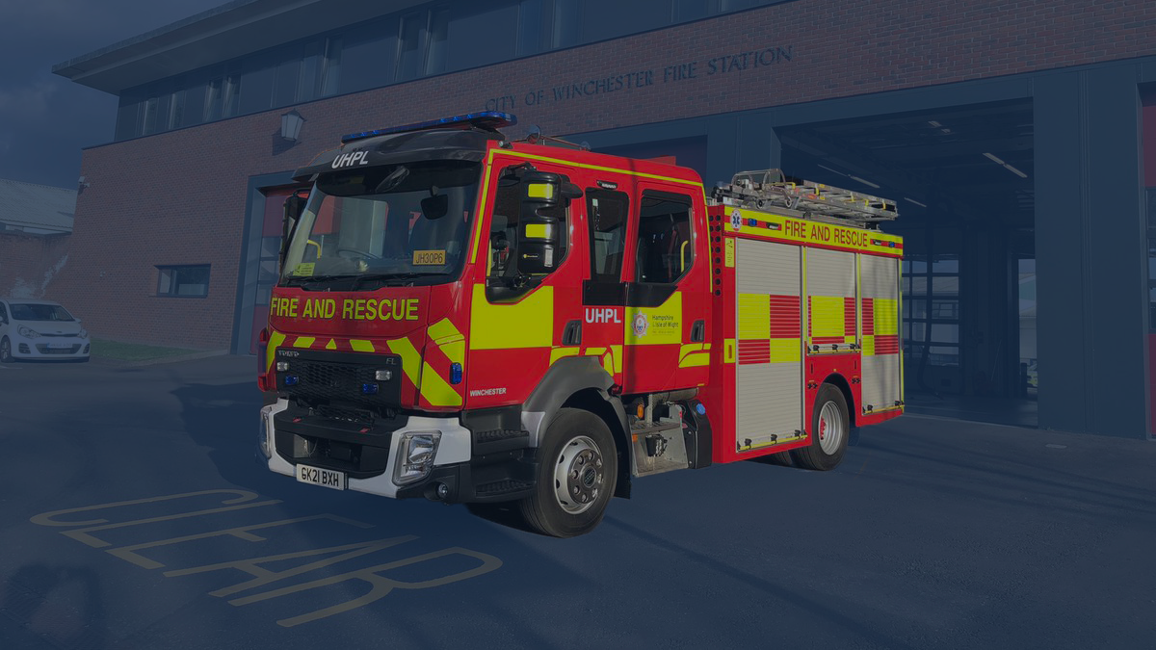

Slide 2
Hampshire & Isle of Wight Fire & Rescue Service
A basic introduction to
Safe and Well visits

Slide 3
What is a Safe and Well visit?
(Formerly known as a Home Fire Safety Check)
Safe and Well is a Home Fire Safety visit that’s tailored to an individual’s needs, relating to their health and lifestyle choices.
We focus our visits on the most vulnerable people in our community.

Slide 4
What is the aim of a Safe & Well visit?
The dwelling has at least one working smoke alarm on each occupied level
The residents have a prepared plan of escape in the event of fire
Advice and guidance is given for any risks found or hazardous practices that may increase the likelihood of fire
Specific risks that require other actions are referred to other agencies, where appropriate, for additional support

Slide 5
Smoke Alarms
Well placed smoke alarms properly installed and maintained, in conjunction with a prepared and practised plan of escape, are the main factors known to reduce the risk of fatality from fire within domestic dwellings.

Slide 6
FireBlitz FHB10
10 year battery life
Optical sensing with thermal enhancement (detects sudden temperature changes)
Can be used near kitchens and reduces nuisance alarms from cooking fumes.
Large test/silence button

Slide 7
Fire Angel ST-750
10 year battery life
Optical sensing with thermal enhancement (detects sudden temperature changes)
Can be used near kitchens and reduces nuisance alarms from cooking fumes.
Large test/silence button

Slide 8
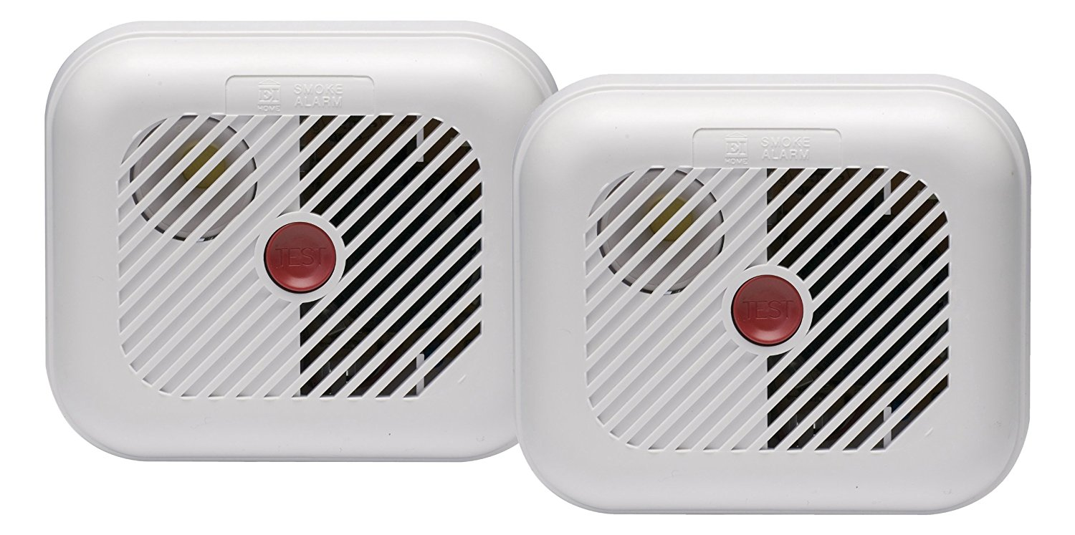
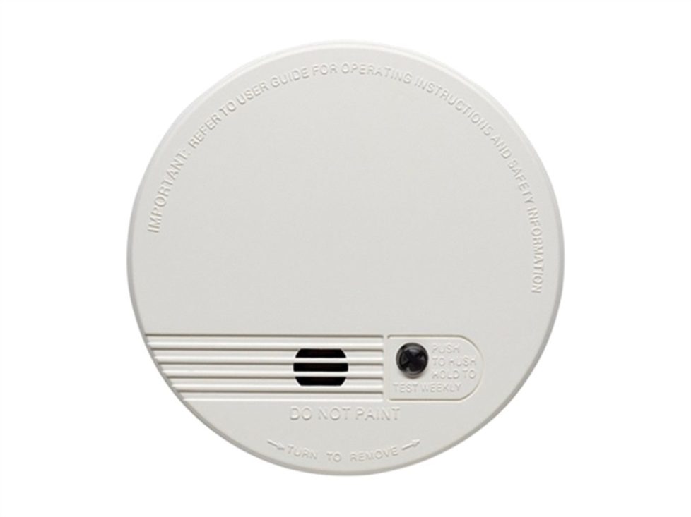
Other styles
Other types require replacement batteries

Slide 9
Smoke alarm check
Test smoke alarm
Check location is suitable
Advise to test once a month
Advise to hoover around sensor on regular basis
Make sure occupants can hear the alarm at all times of day
Ensure children know what to do on activation

Slide 10
Smoke alarm advice
One on each level
Not in the kitchen unless a heat alarm ( cooking fumes )
Not directly outside a kitchen or bathroom ( fumes and steam )
Advise one in each high risk room i.e. Utility or PC room
Never remove the battery until a replacement is available

Slide 11
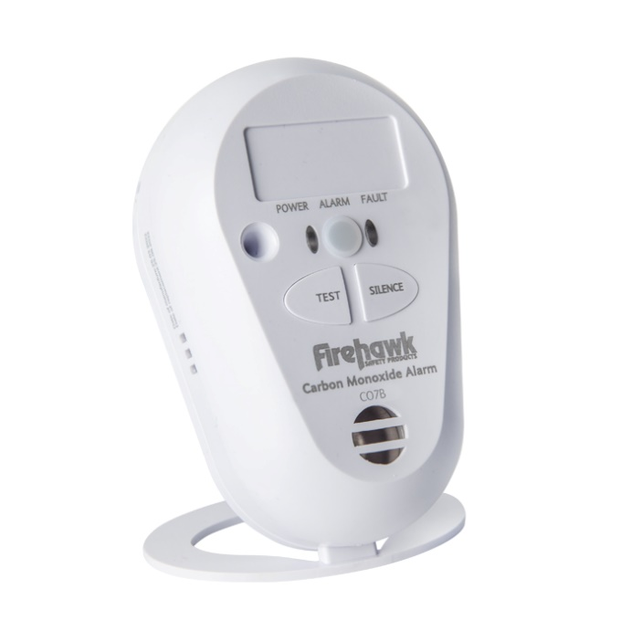
CO Alarms & advice
CO ( Carbon Monoxide) gas is given off when solid fuels are burnt
CO gas is odourless, tasteless & invisible – its called the silent killer
Test alarm is working
One in each room where there is solid fuel burning appliance i.e. log burner, coal fire, gas boiler
If alarms sounds, open all windows and ventilate property. Consider calling gas engineer.

Slide 12
Identifying risks
Electrical safety
Kitchen safety
Smoking
Candle/matches safety
Safe storage of flammables
Fires/heaters/chimney
Trip hazards
Hoarding/clutter
Escape routes

Slide 13
Electrical safety
Look for overloading of sockets

Slide 14
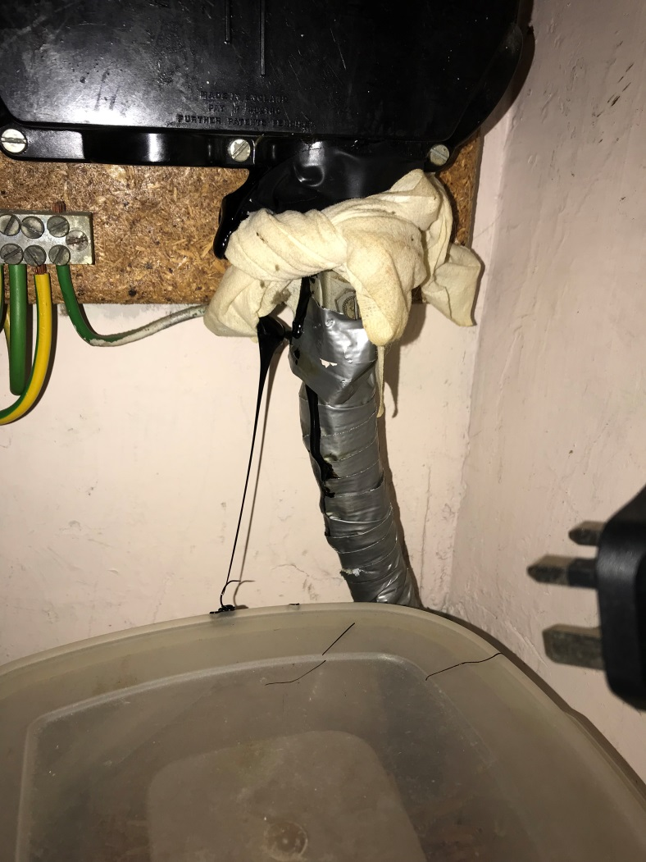
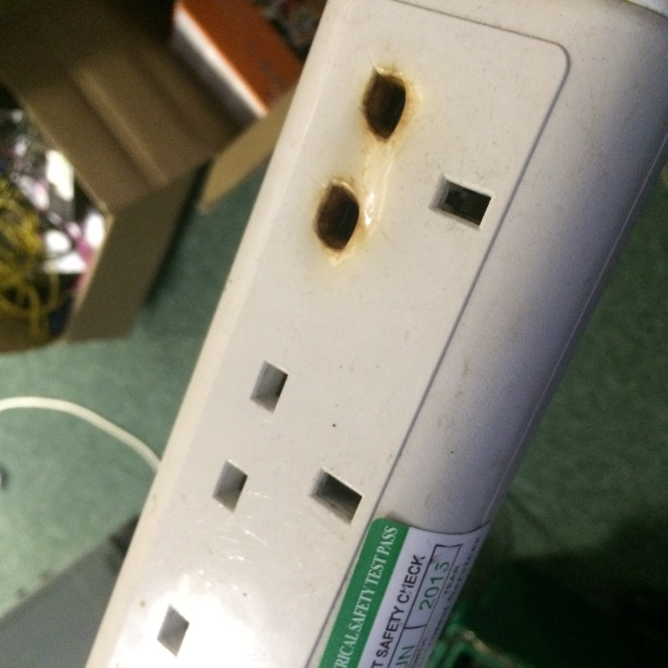
Look for signs of over heating around sockets and main supply

Slide 15
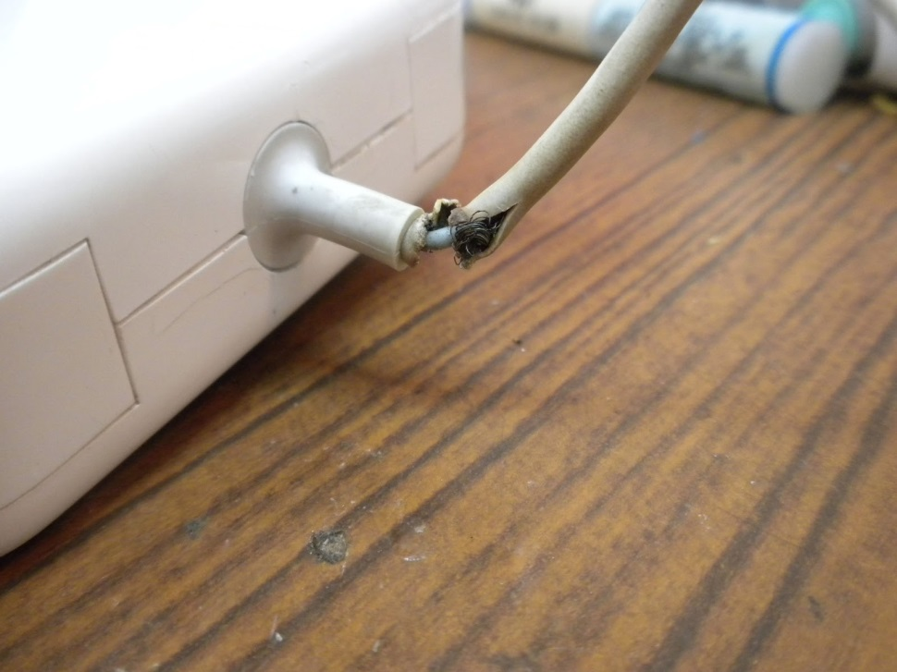
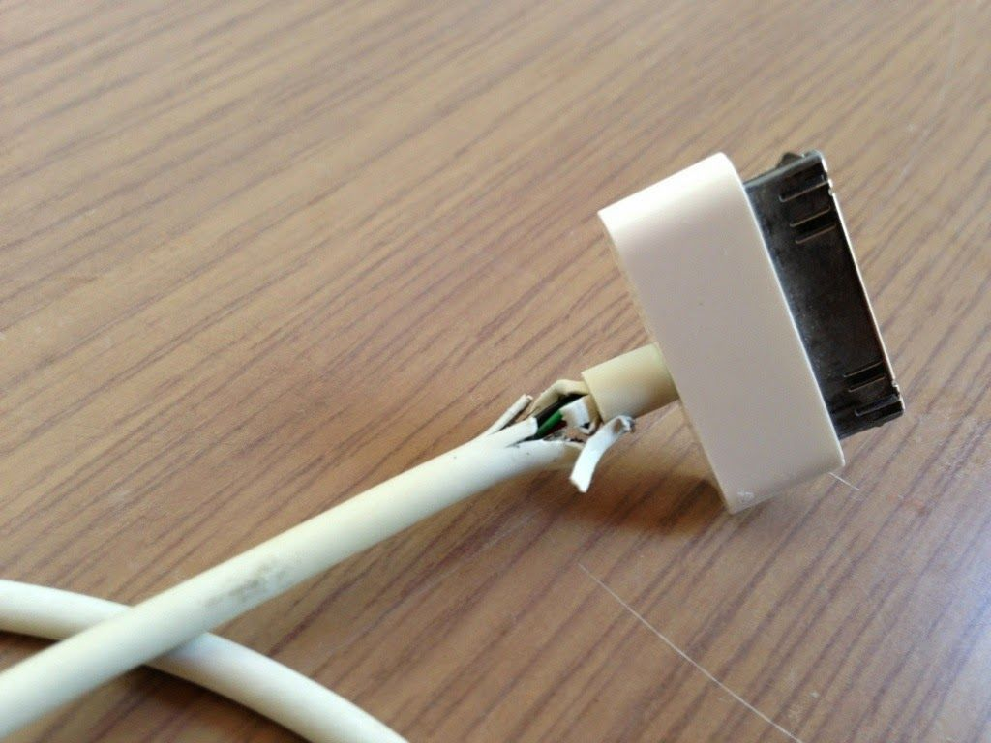
Look at cable condition

Slide 16
Check the immersion heater
Check the cylinder for corrosion
Check around the element
Look for scorching on the cables
Check for leaks
Safe storage around cylinder

Slide 17
Smoking
Never smoke in bed
Always stub out completely
Always use correct ashtray
Empty ashtray regularly
Never leave lighters/matches where children can get hold of them
Look for burn signs on furniture – indicates carelessness

Slide 18
Candles/Matches
Matches and Lighters out of reach/view of children
Only use candles in proper holders
Candles not placed near curtains or furniture
Never leave unattended
Make sure out when go to bed.

Slide 19
Flammables
Stored in small quantities
Stored in proper containers
Kept away from heat/ignition sources
Not kept in the main house

Slide 20
Kitchen Safety
When using toaster pull from under cupboards
Clean out crumbs on regular basis
Tea Towels away from cooker
Turn off cordless kettles when not in use
Clean oven and grill regularly
Any gas boiler/fire must be serviced once a year.

Slide 21
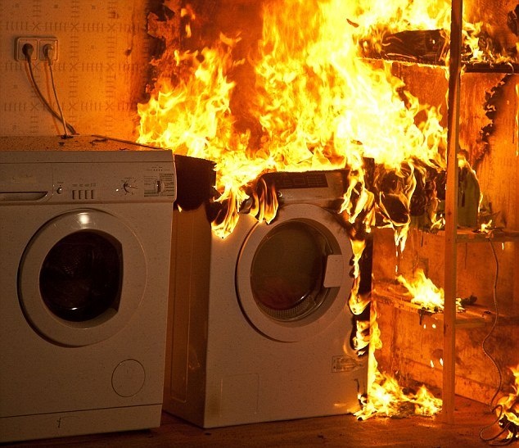
Washing machines and tumble driers
Never use at night time when in bed
Never use when out of the house
Check pockets of clothes
Always clean the filter after every use
Do not overload

Slide 22
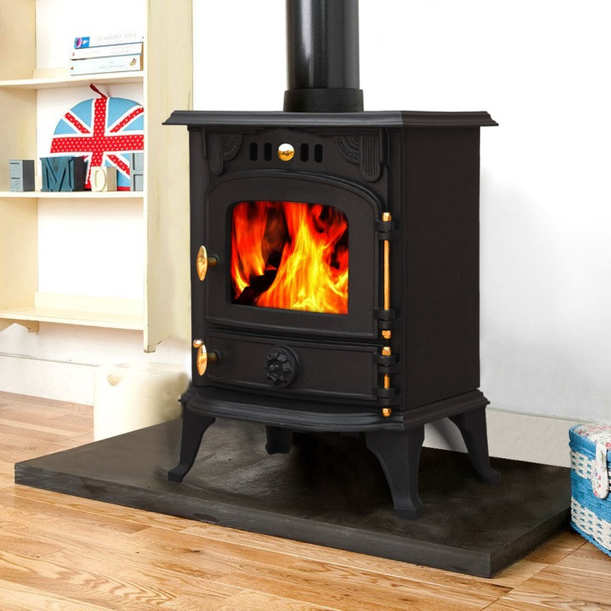
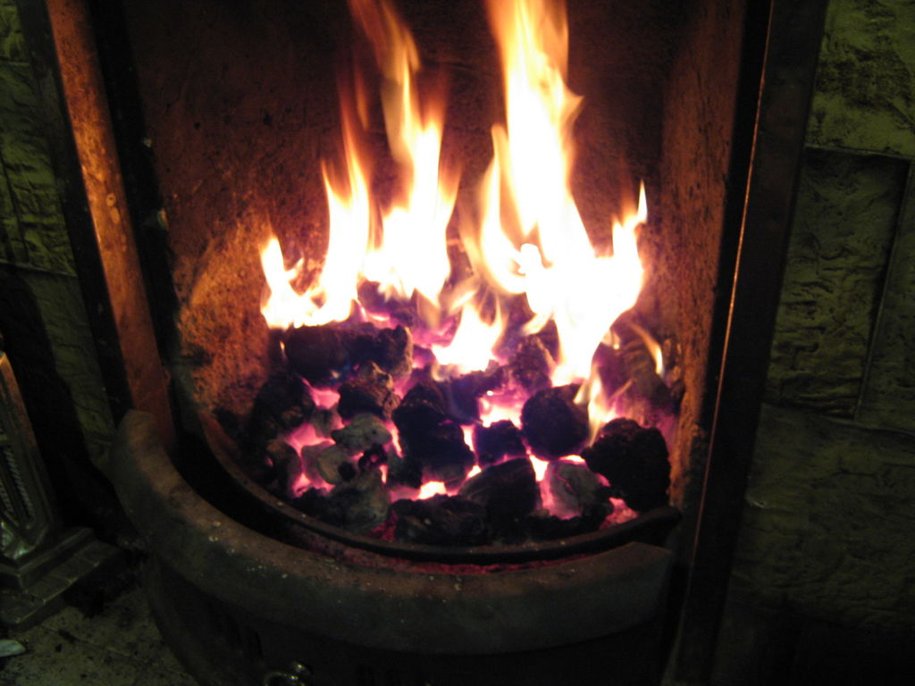
Log burners and open fires
Sweep chimneys twice a year
Never leave unattended
Make sure CO alarm present
Use a fire guard and keep combustibles away

Slide 23
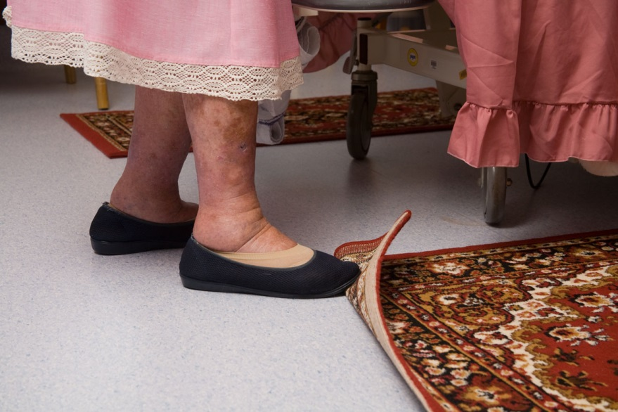
Trip Hazards
The elderly are very vulnerable to falling and breaking bones – for many this can be life changing
Identify any trip hazards
Minimize the risk
Make sure escape routes are clear of obstructions

Slide 24
Hoarding/Clutter
Excessive hoarding/clutter is a fire risk not only to the occupants but also to surrounding properties and Fire Crews that may have to enter and search.
If 7 or above, Enhanced Response Plan activated.

Slide 25
Hoarding/Clutter
Minimise source of ignition/fire loading
Keep escape routes/exits clear
Ensure working smoke alarms are present
Consider neighbour visit for working smoke alarms

Slide 26
Fire escape plan/route
Discuss night time routine
Means to contact 999
Closing doors
Switching off appliances
Identify escape exits
Make sure exits are clear
Make sure exits work
Assembly point for all occupants

Slide 27
Contact Us: Tel: 023 8062 6751 www.hantsfire.gov.uk

Slide 28
Any Questions?

